Slide 1
Detection of Lung Cancer using Segmentation from CT Images
MSCSF19M020 Celal Ahmad
MSCSF19M029 Abubakar

Slide 2
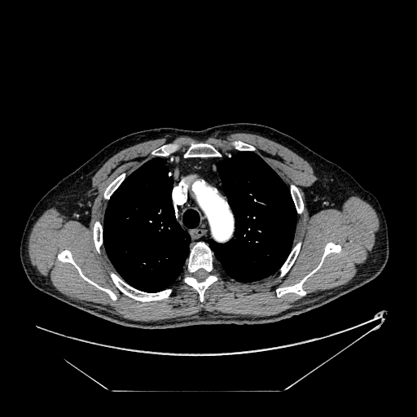
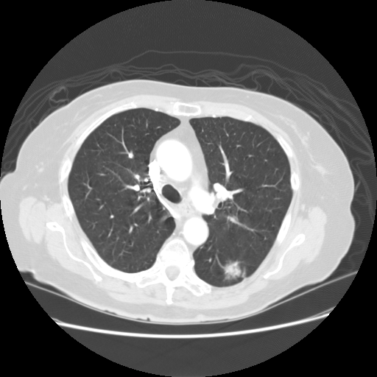
Lungs Nodule Detection
We have refined previous algorithm and changed it according to the lung window, previously it was done for mediastinal window as explained and shown in image below.
So, we selected 10 patients data and identified nodules containing ct slides with the help of doctor. Then, we further selected 3 patients out of 10 identified patients.

Slide 3
Proposed idea for nodule detection
Idea to detect nodule was too simple:
Identify nodule on the basis of shape in single ct image slide i.e circular,spherical shape and then look for that nodule in some number of neighbouring ct slides if that nodule occurs at same place in almost all selected neighbouring ct slides then most probably that is the nodule you looking for.

Slide 4
Experimented Solutions
1) Applying canny edge detection and then looking for circular contours
2) Applying canny edge detection and then looking for circularity property of contours
3)Thresholding with same above mentioned two methods i.e circular contours and circularity property of contours.
All the four methods did not give the desire solution.

Slide 5
Algorithm for nodule detection
1) Apply Gaussian blur on lungs segmented image
2) Threshold lungs segmented image using cv2 thresholding and refine it with morphology operations i.e Opening and closing
3) Detect circular shape using Hough transformation and draw circle around detected circular shape
4) Look other neighbouring ct slides and identify if any nodule present in all selected ct slides

Slide 6
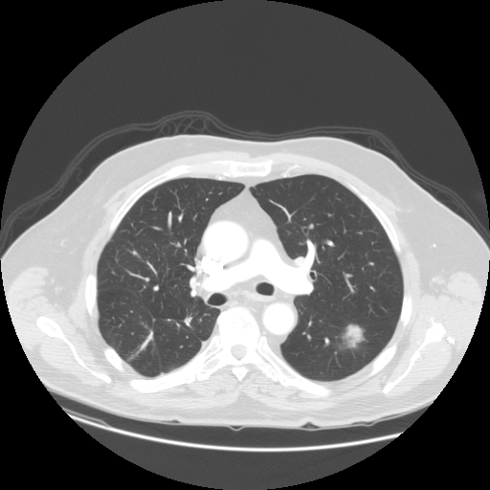
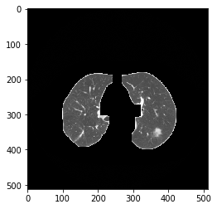
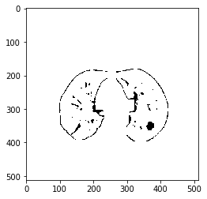
Patient 1
Slide 1

Slide 7
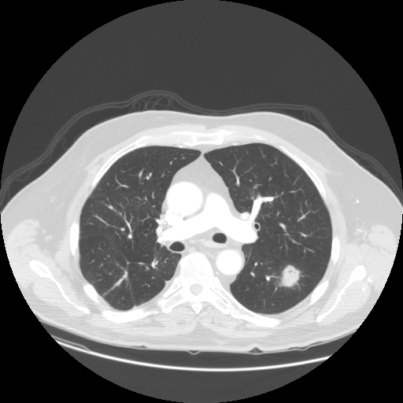

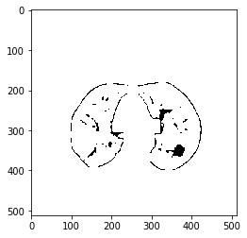
Patient 1 cont.
Slide 2

Slide 8
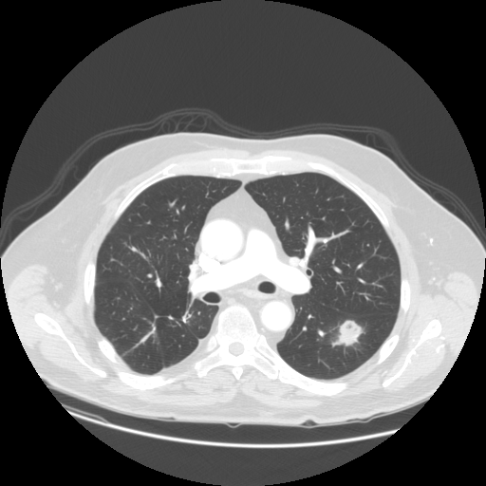

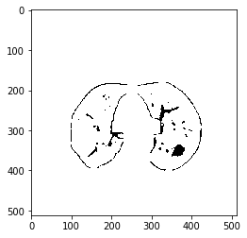
Patient 1 cont.
Slide 3

Slide 9
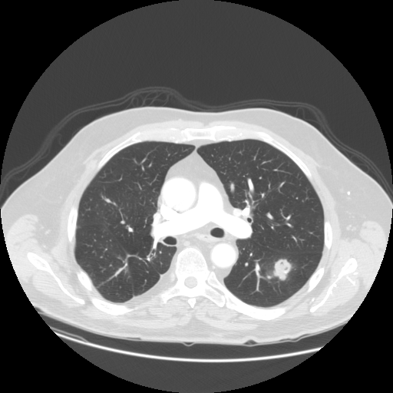


Patient 1 cont.
Slide 4

Slide 10
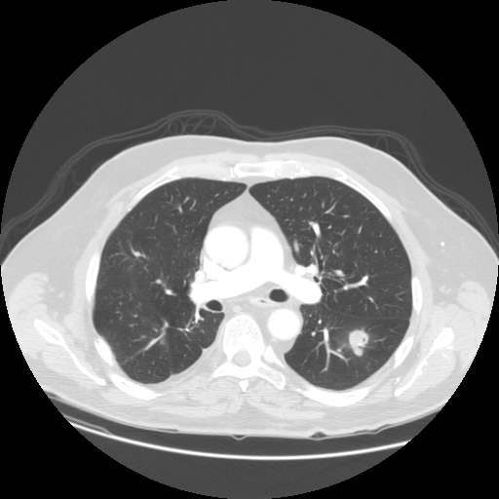

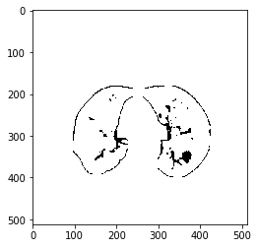
Patient 1 cont.
Slide 5

Slide 11
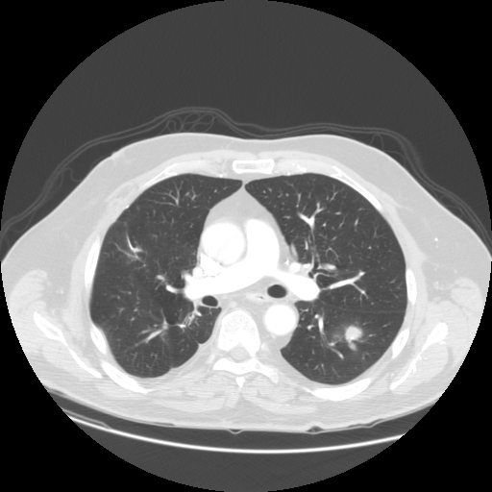
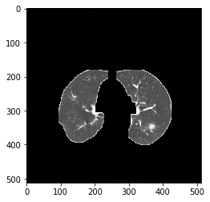
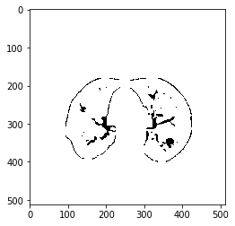
Patient 1 cont.
Slide 6

Slide 12
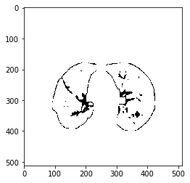
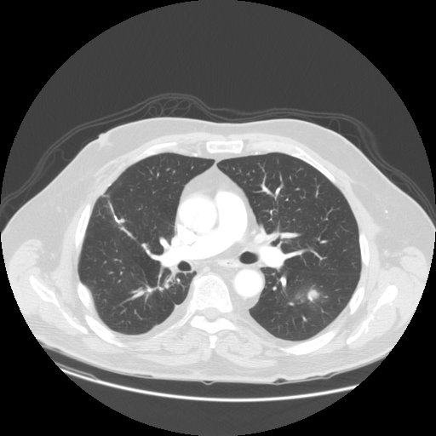

Patient 1 cont.
Slide 7

Slide 13
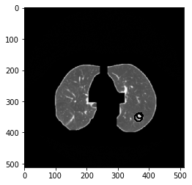

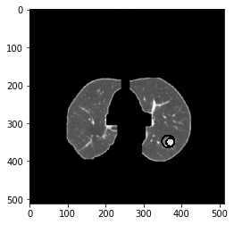
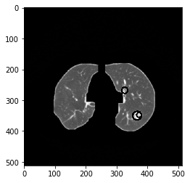

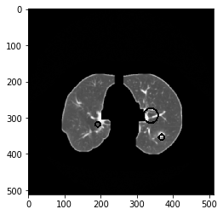
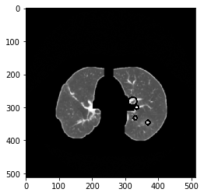
Patient 1 Result

Slide 14
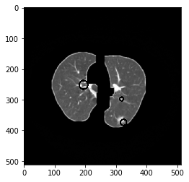
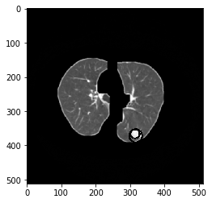




Patient 2 Result

Slide 15
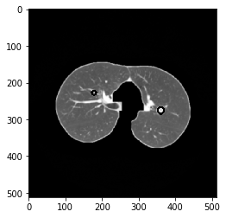
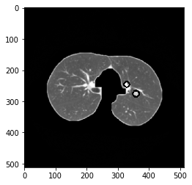
Patient 3 Result

Slide 16
Future Work
1) Improvement of the whole project if needed.
2) Blob Detection could give us better results. So, we will apply blob detection instead of circle detection in future.
3) We will do classification as all the features extraction code is ready to use.

